Slide 1

ASSIGNMENT – 01
COURSE : AWS DEVOPS
Trainer : Mr . MADHUKAR
NAME : D SARITHA
Mail id : dosalasaritha123@gmail.com

Slide 2
3.Create ebs and attach volume to an instance and unmount the volume and attach to another instance

Slide 3
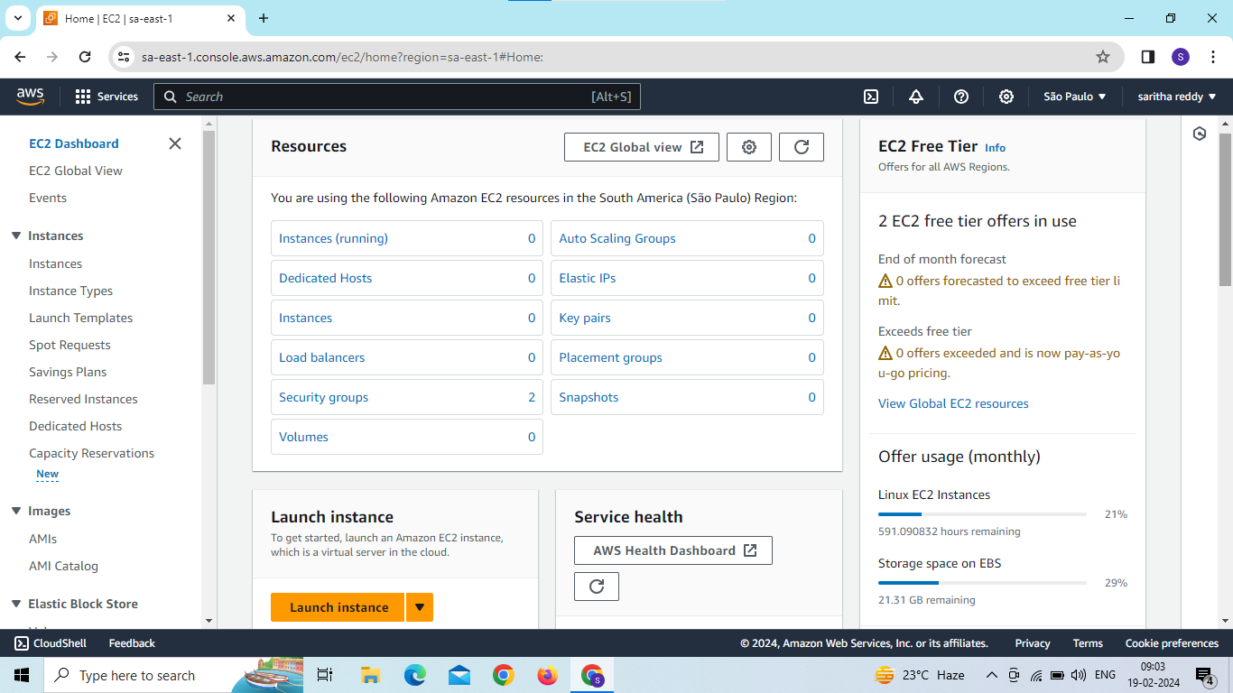
Now we are in EC2 dashboard and click on instances

Slide 4
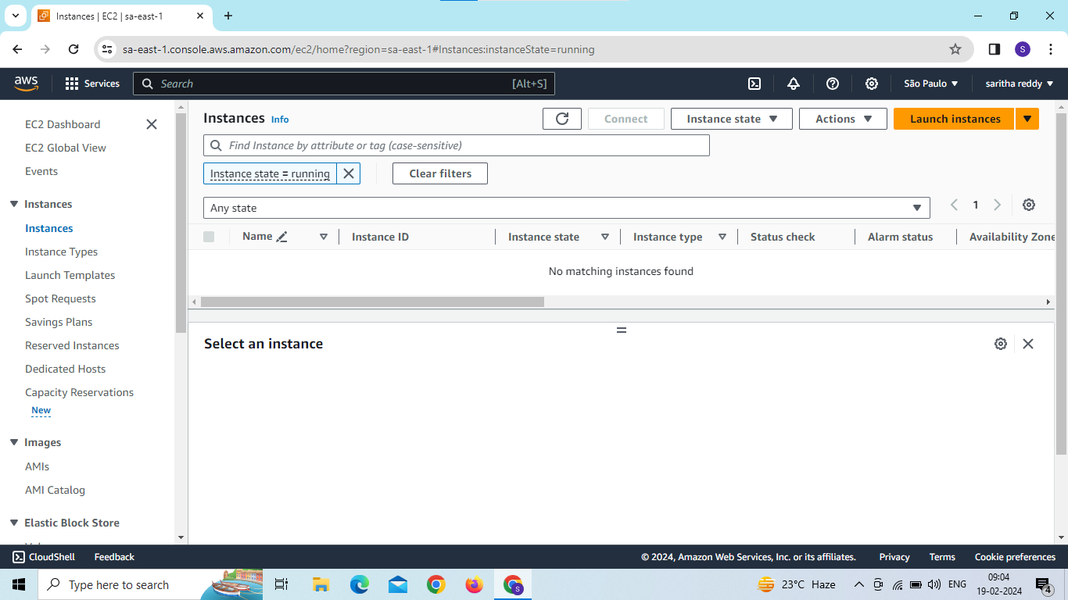
Now create one server in any region click on launch instances

Slide 5
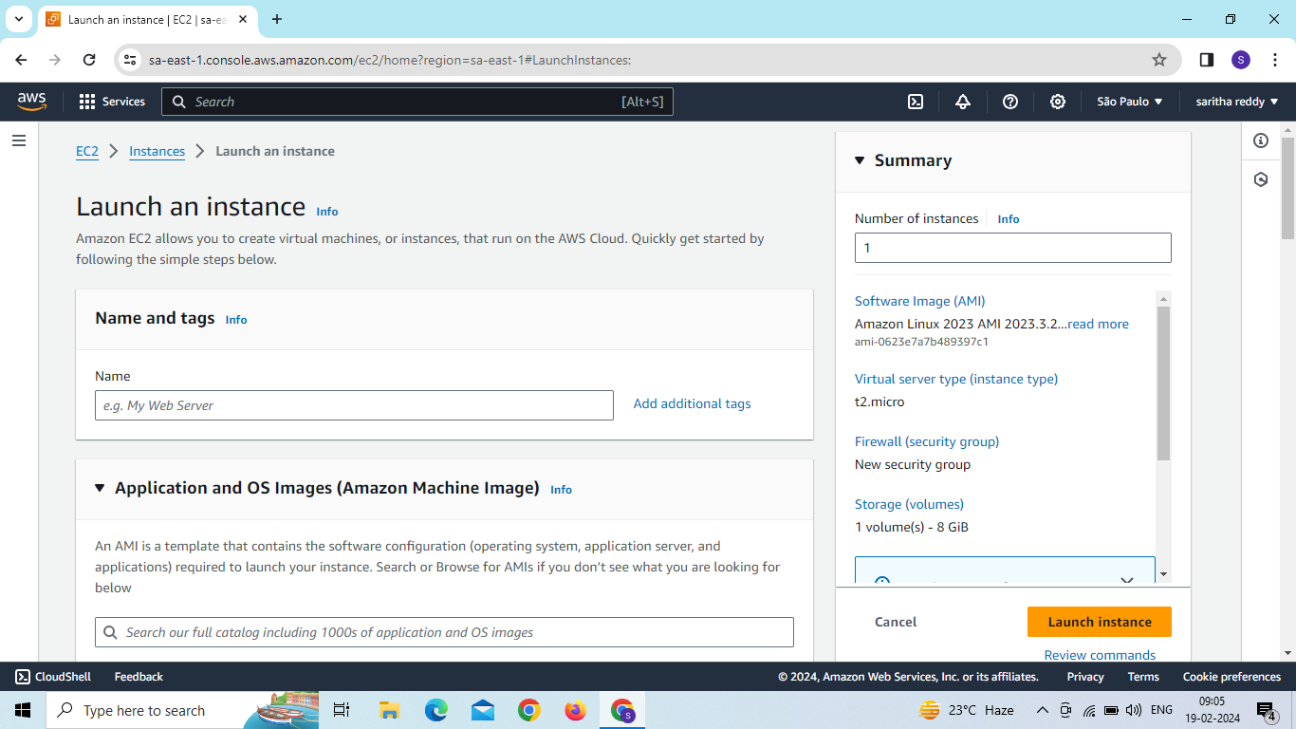
Enter name and select operating system

Slide 6
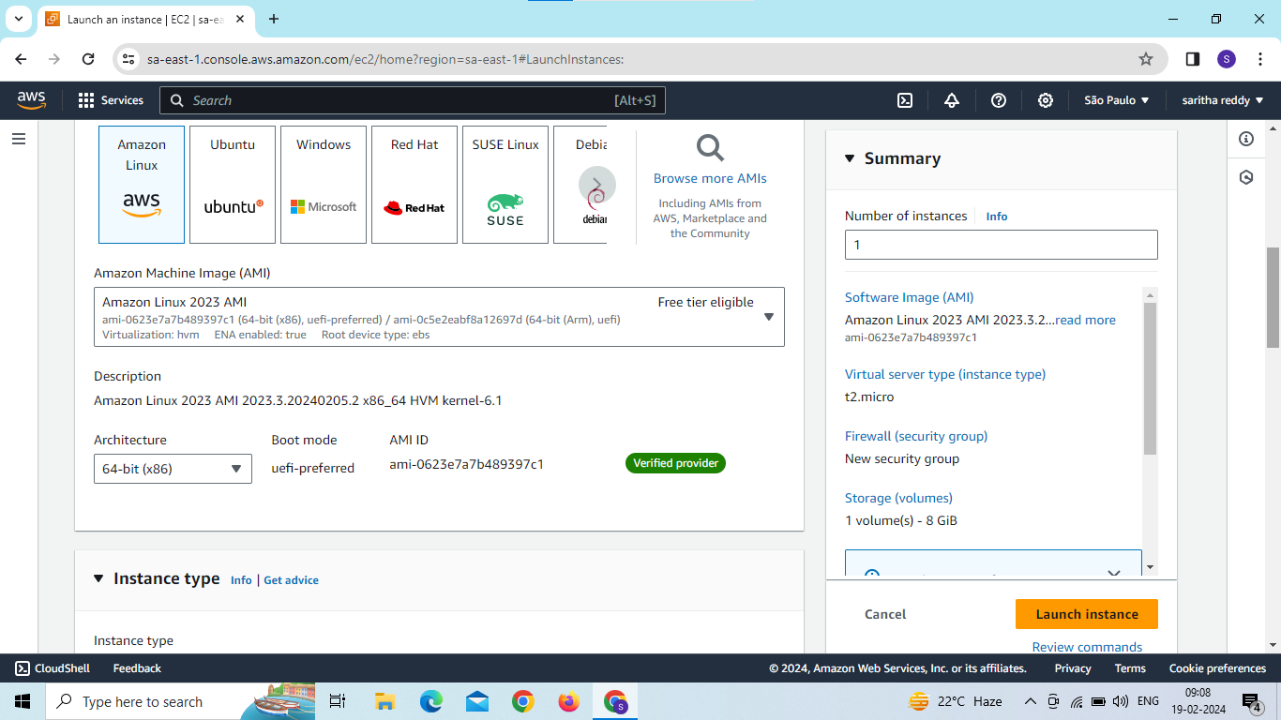

Slide 7
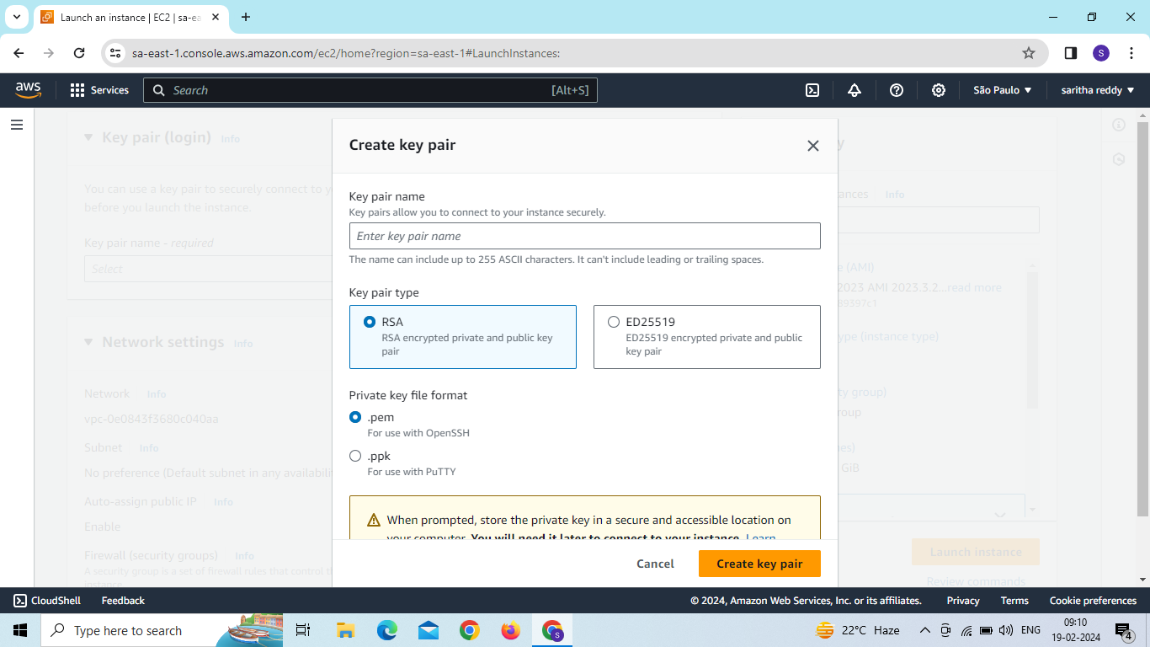
Now create a new key pair

Slide 8
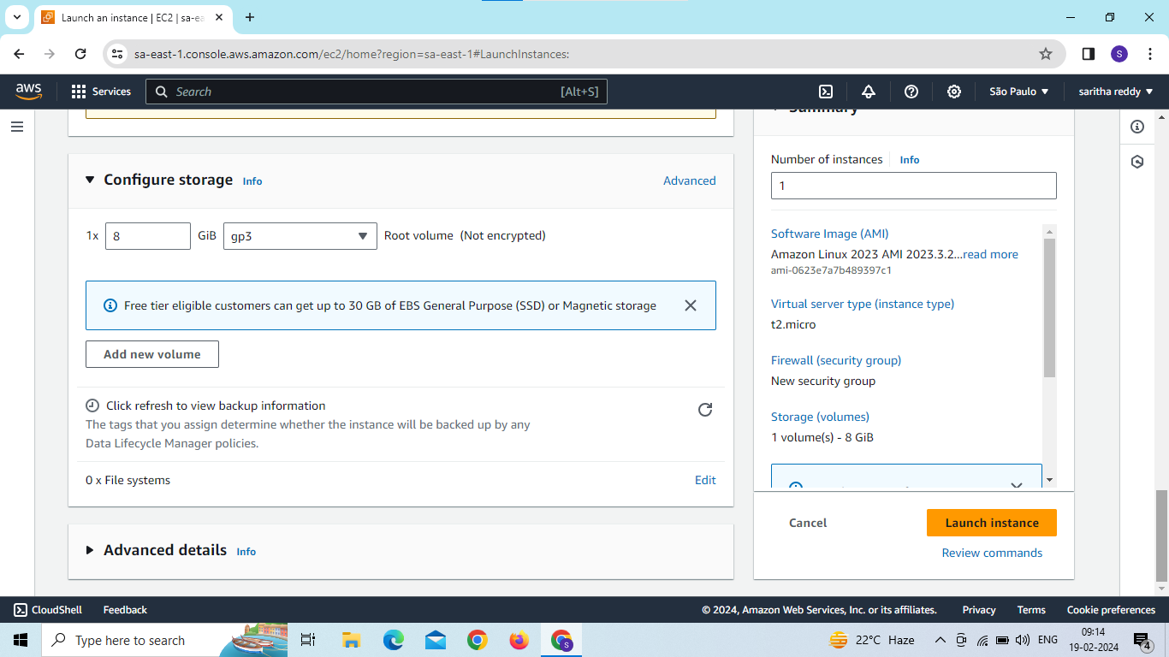
Now click on launch instance

Slide 9
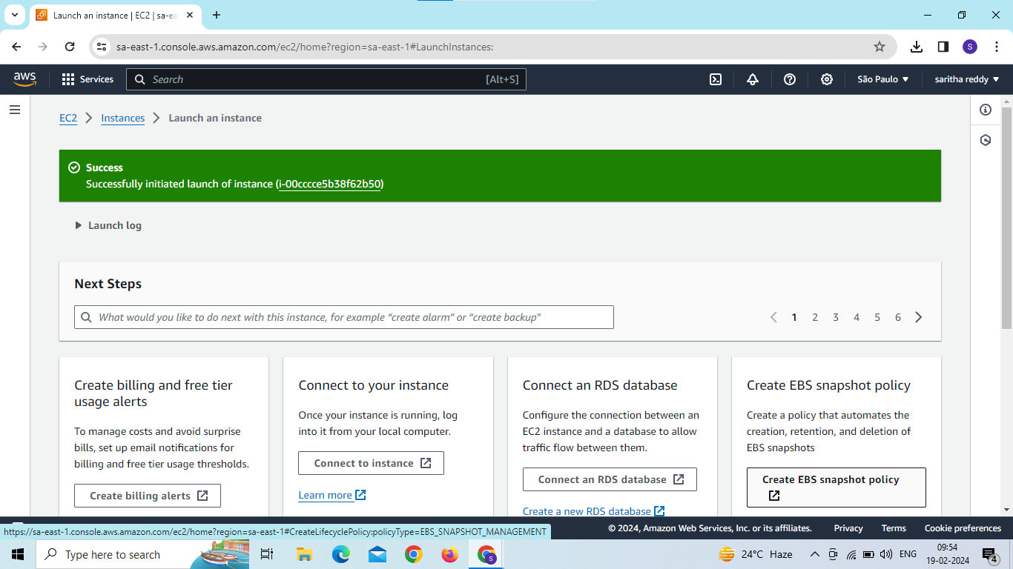

Slide 10
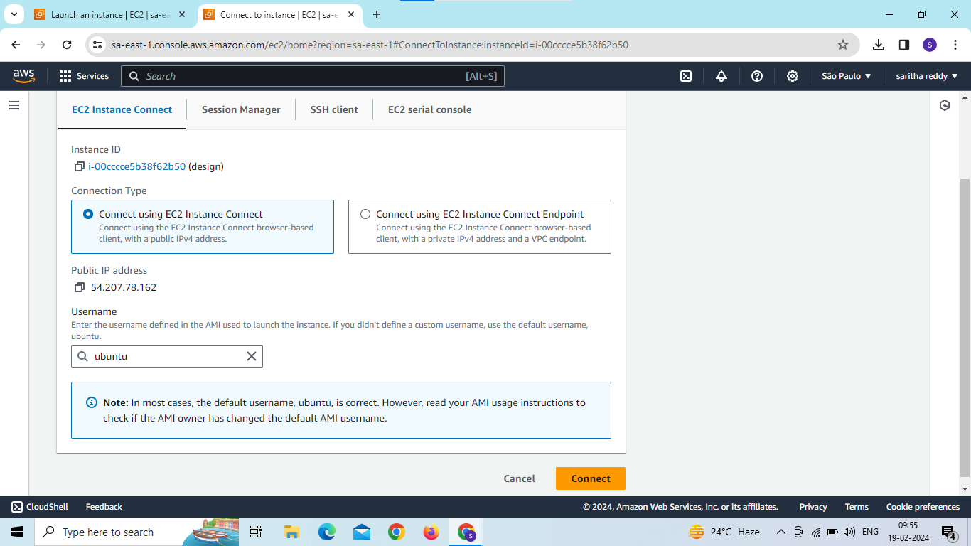
instance created and click on instance id then connect

Slide 11
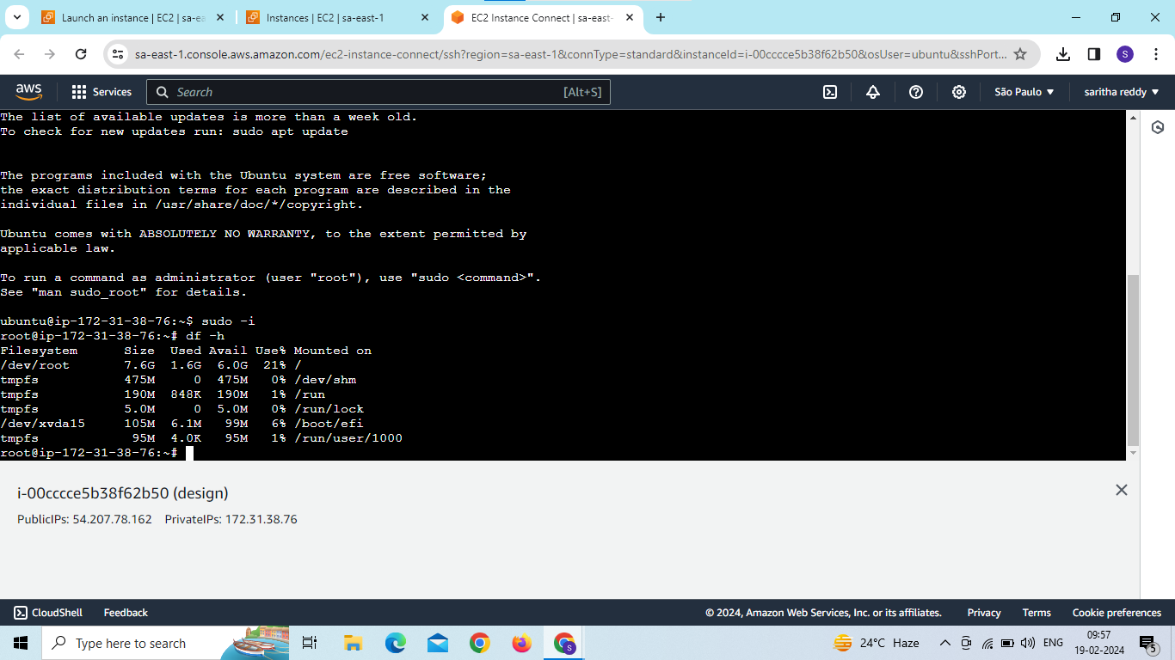
Now connected server

Slide 12
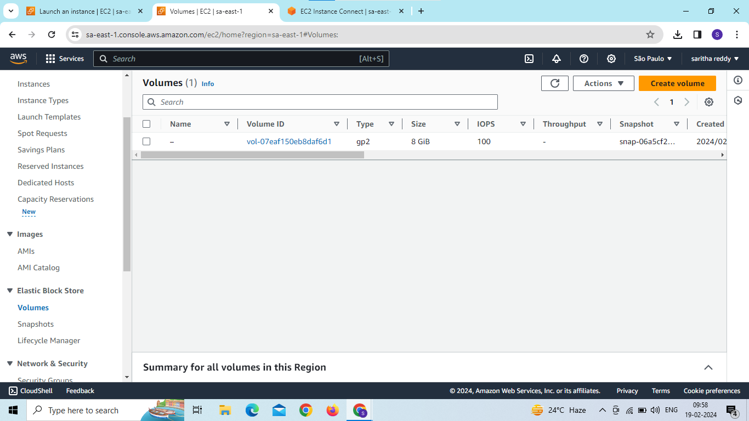
Click on create volume

Slide 13
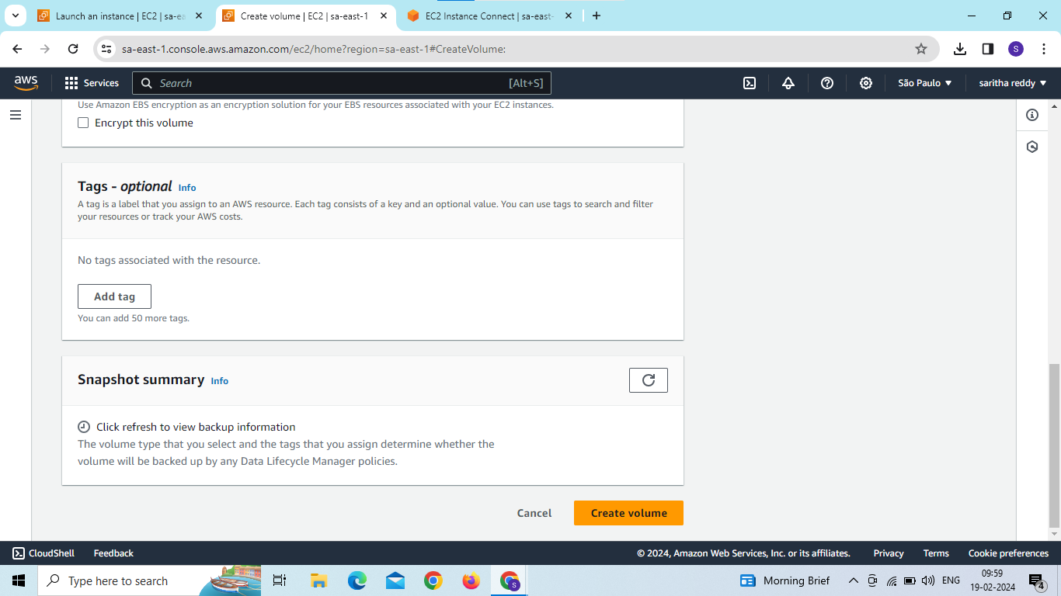

Slide 14
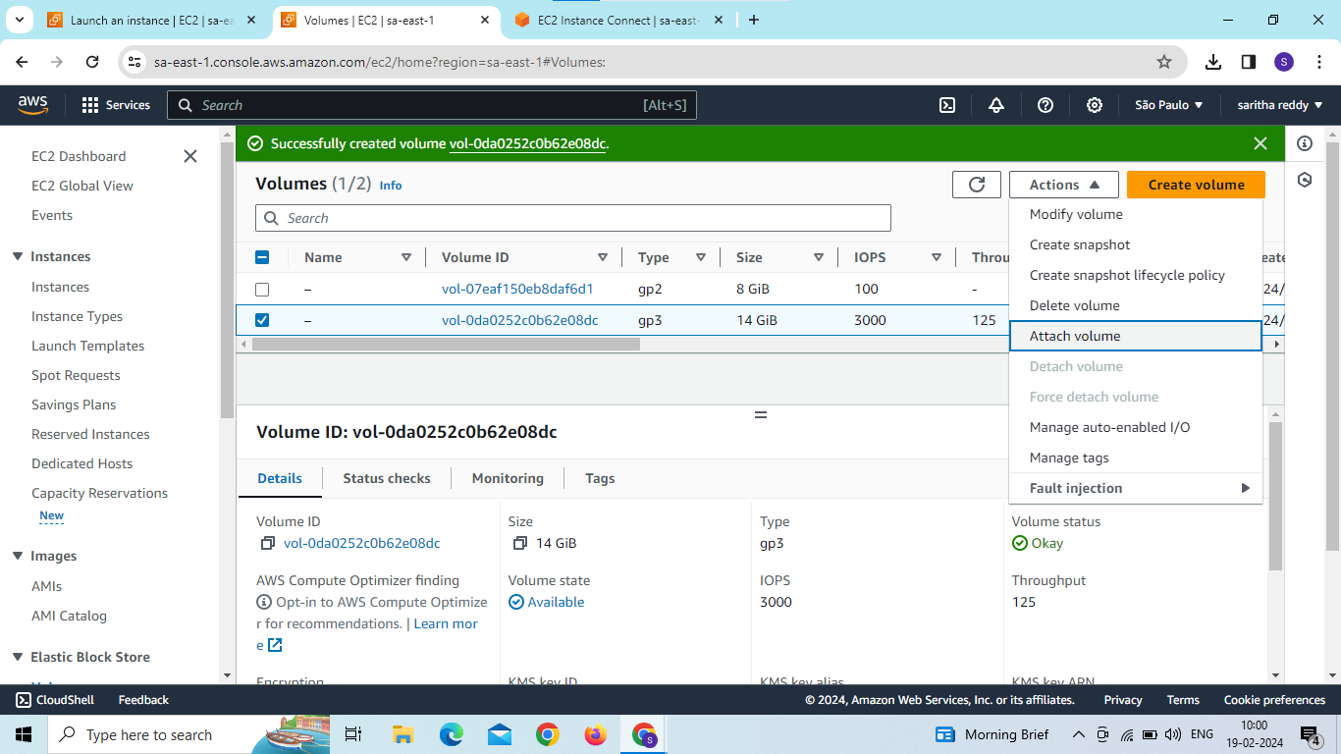
Now the volume created and attach the volume to instance

Slide 15
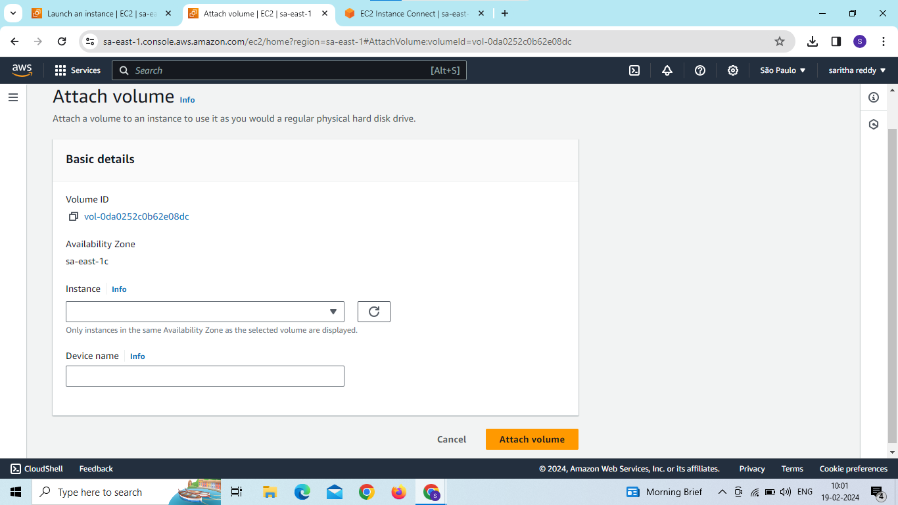

Slide 16
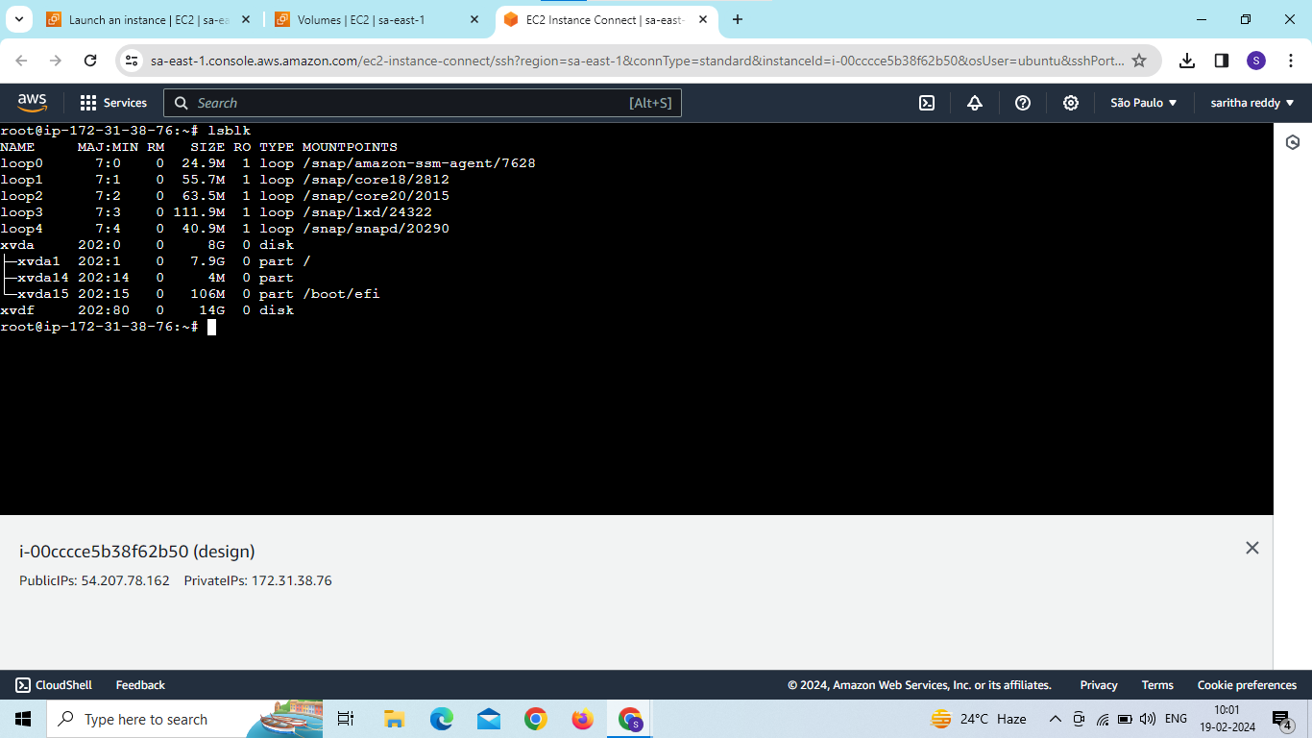
Enter the command for volume is attached or not command is “lsblk”

Slide 17
first to check file system is there or not then create new file system in volume
command is mkfs –t xfs/dev/xvdf
To check file system created or not command is file –s /dev/xvdf
create directories and mount the volumes to directories command is
mkdir –p school/group
Mount/dev/xvdf school/group
Cd school/group
Mkdir 340 341
Vi file1
Ls- to see the files and directories
Cd
Umount/dev/xvdf school/group

Slide 18
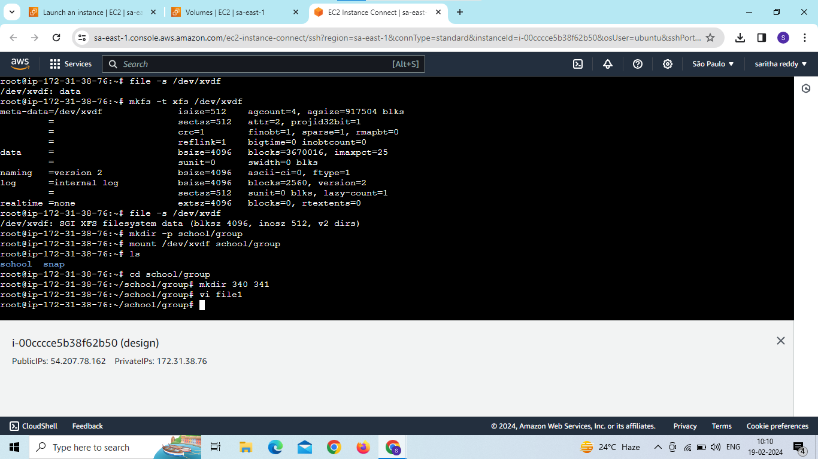

Slide 19
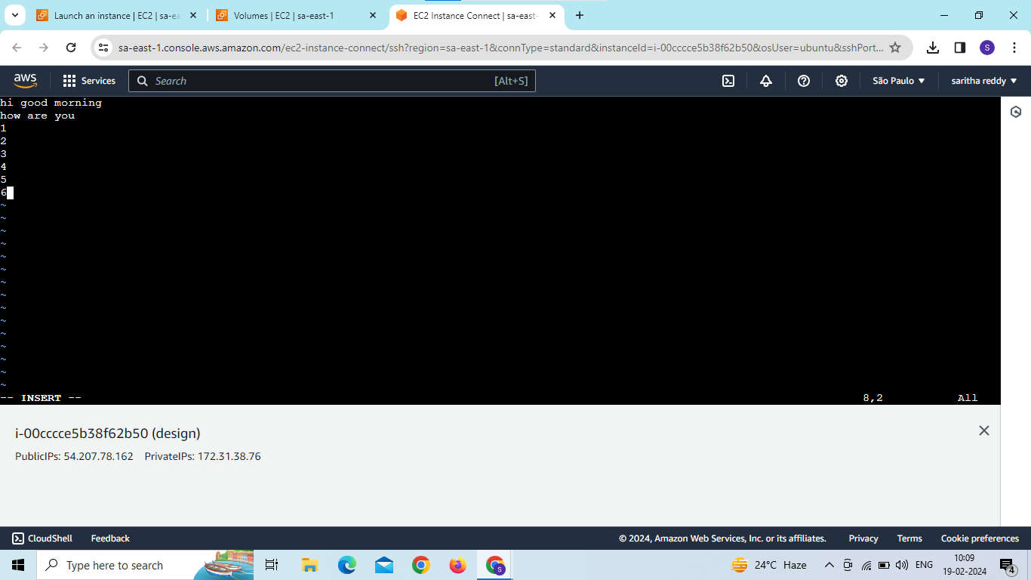

Slide 20
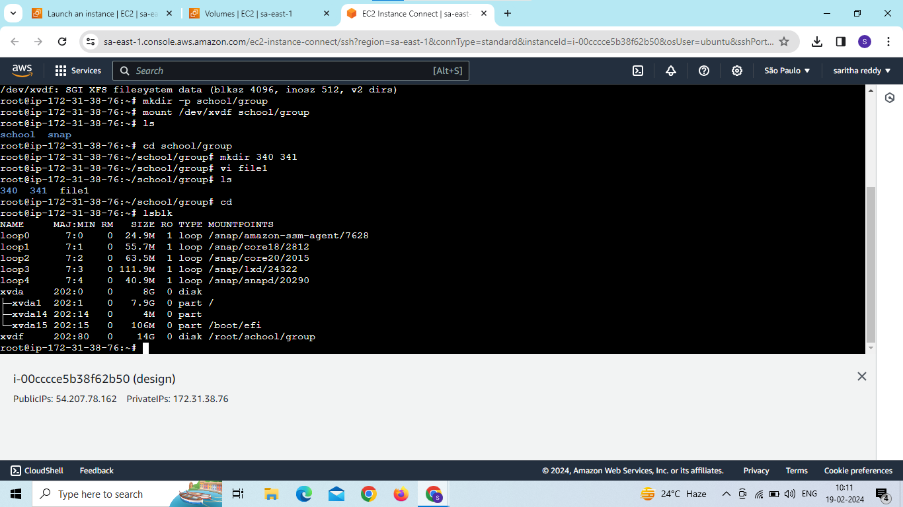

Slide 21


Slide 22
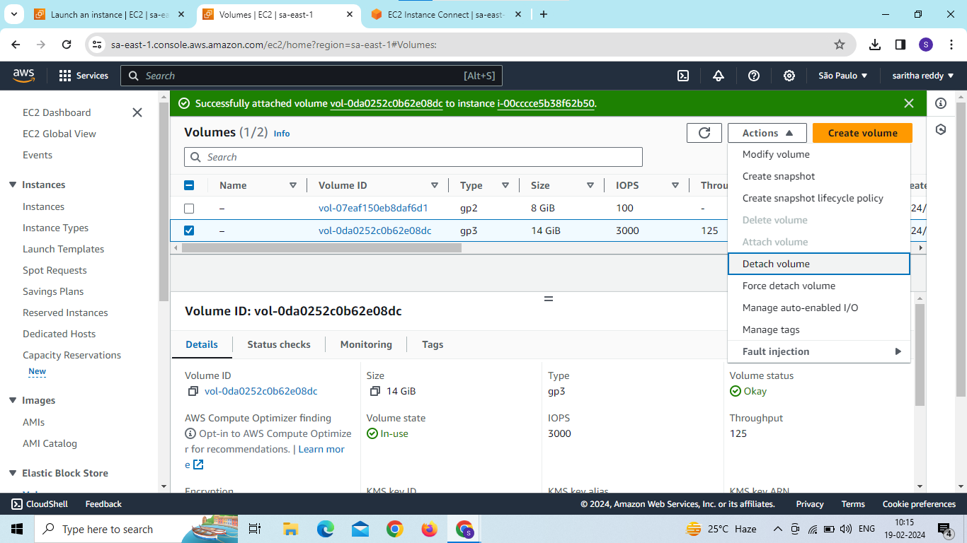
Now go to volumes and detach volume

Slide 23
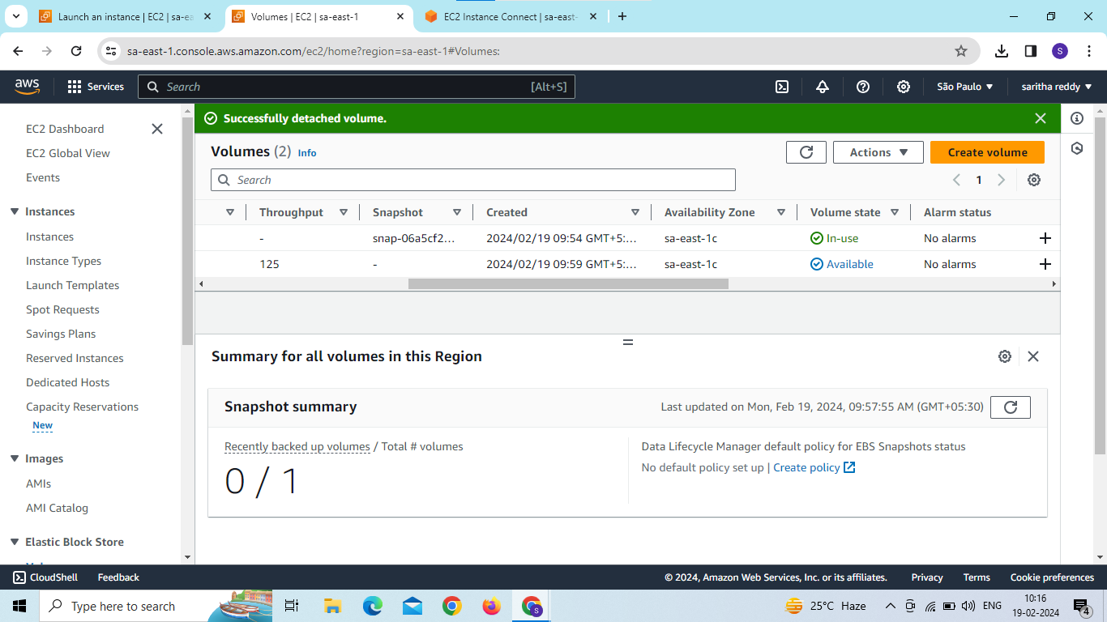

Slide 24
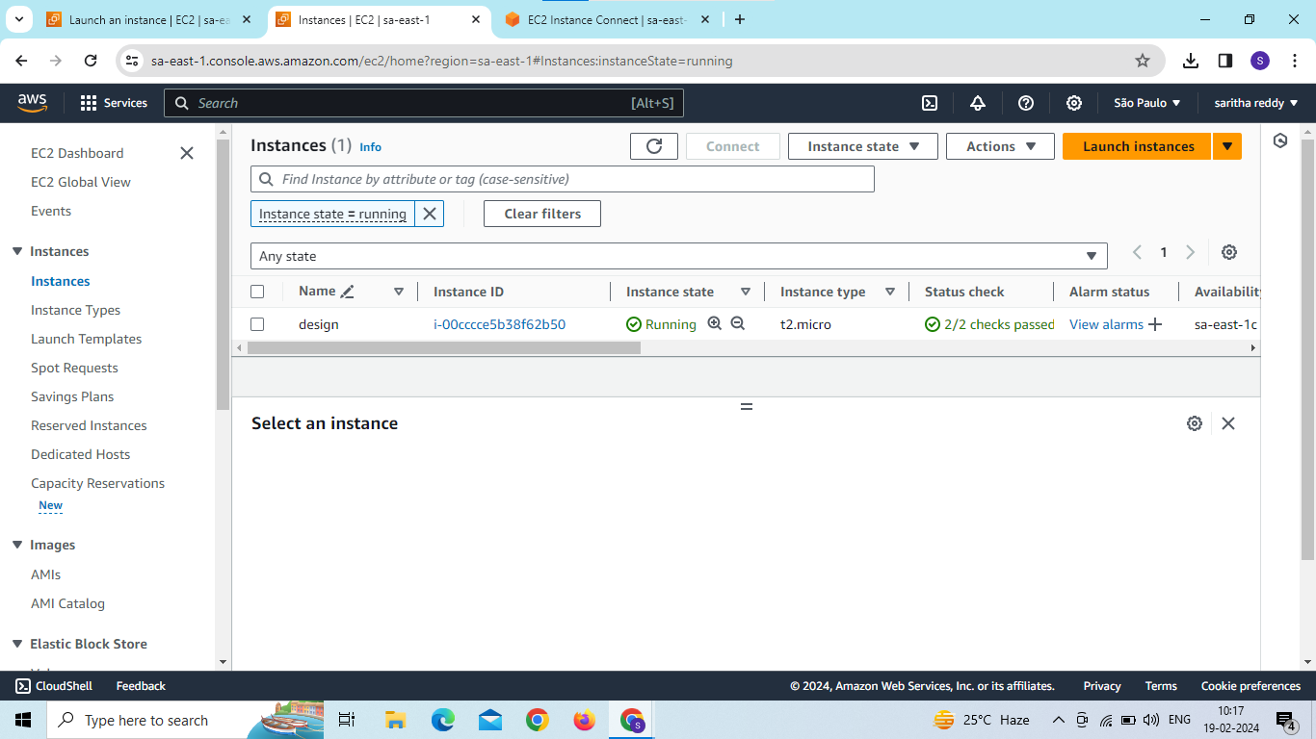
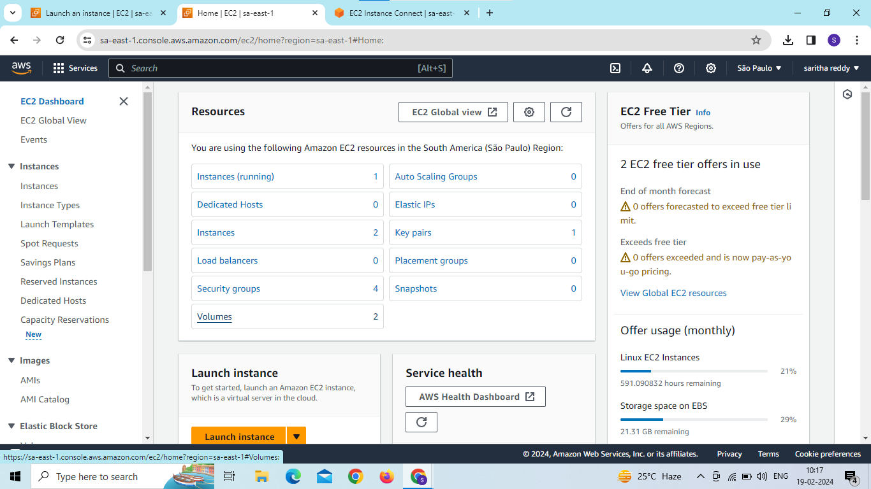
Now we are in ec2 dashboard and create a another instance

Slide 25
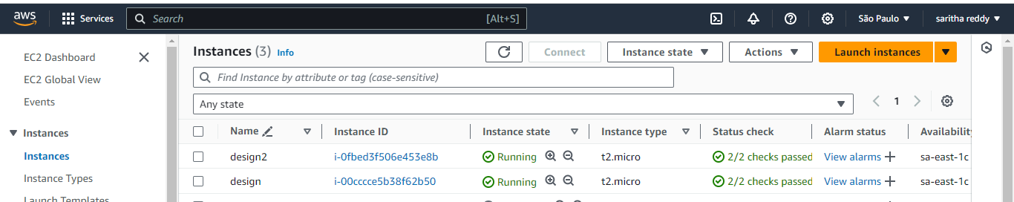

Slide 26
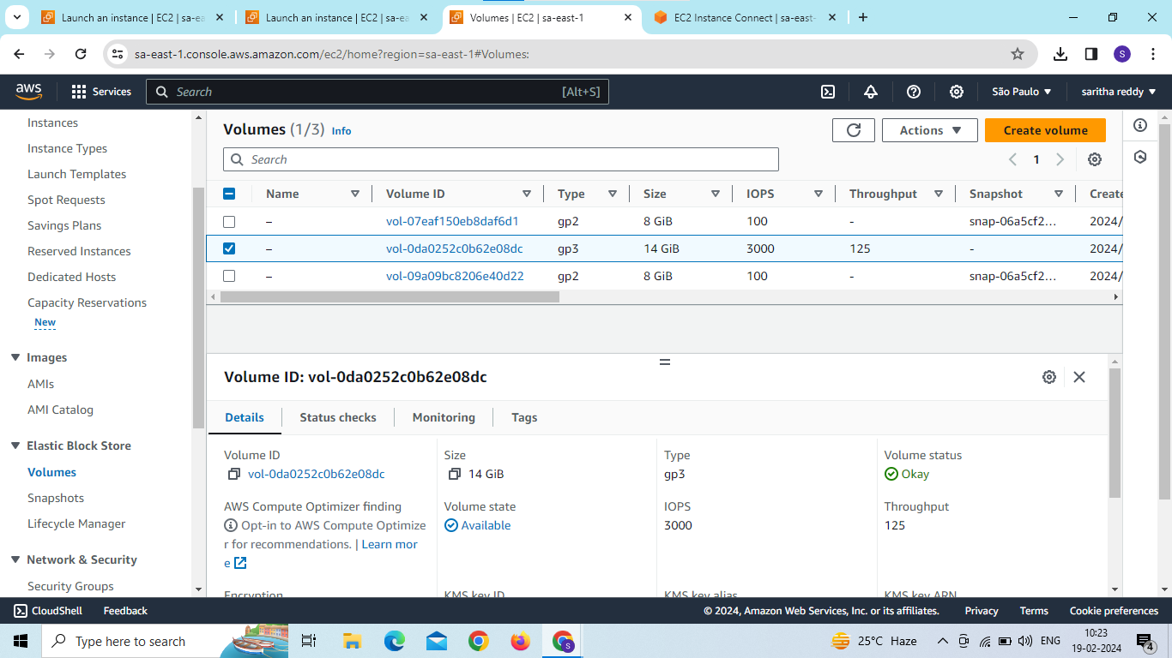
go to volumes and attach volume to the instance

Slide 27
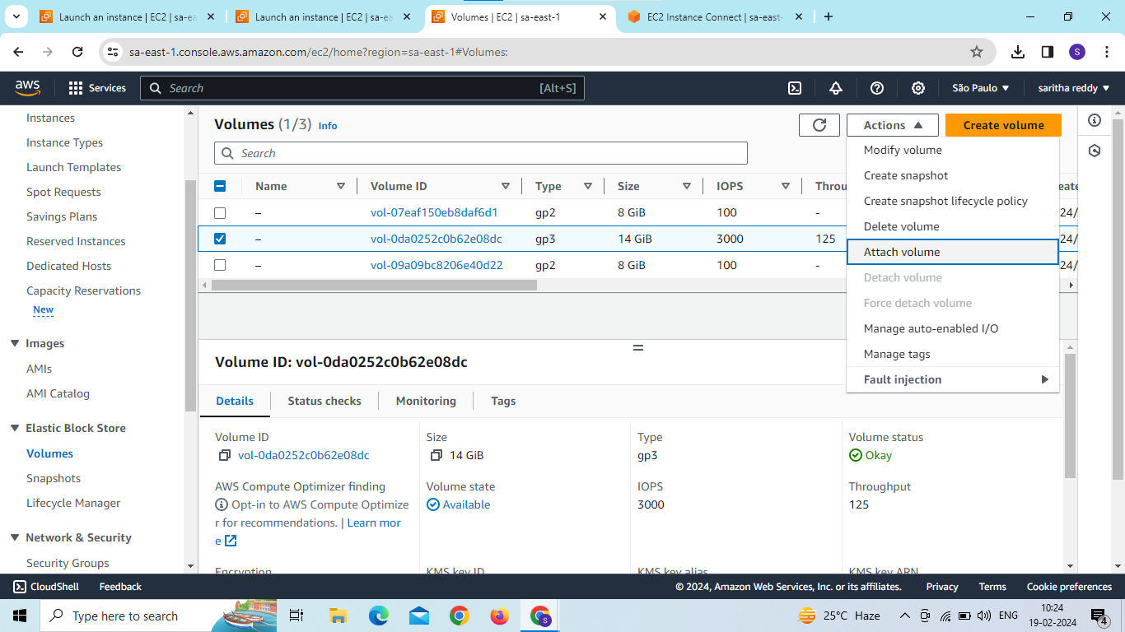

Slide 28
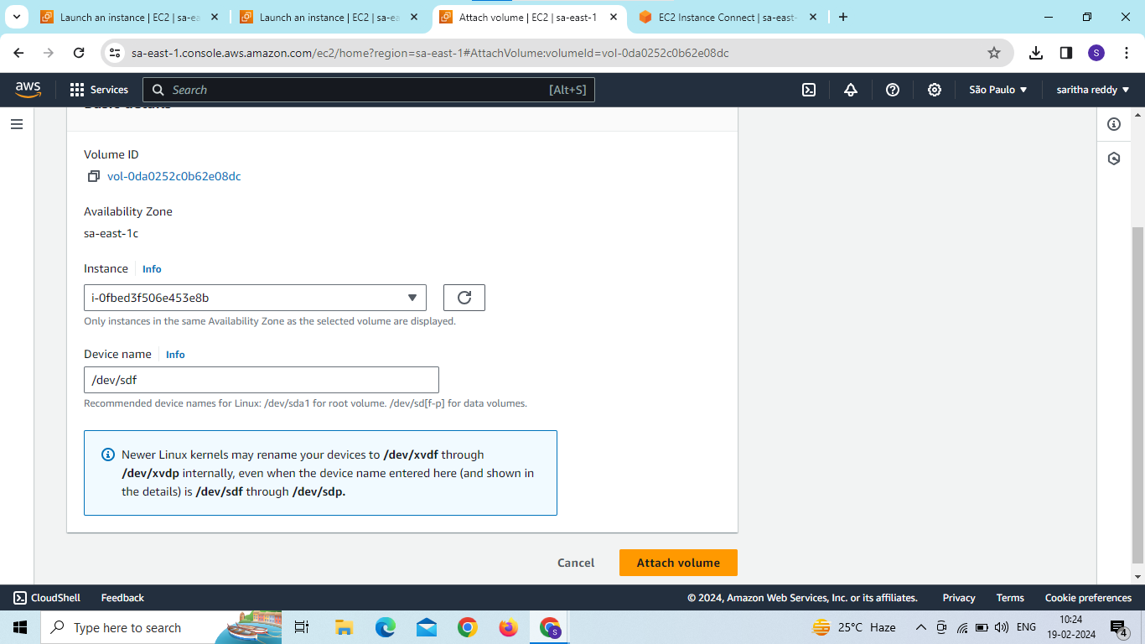

Slide 29
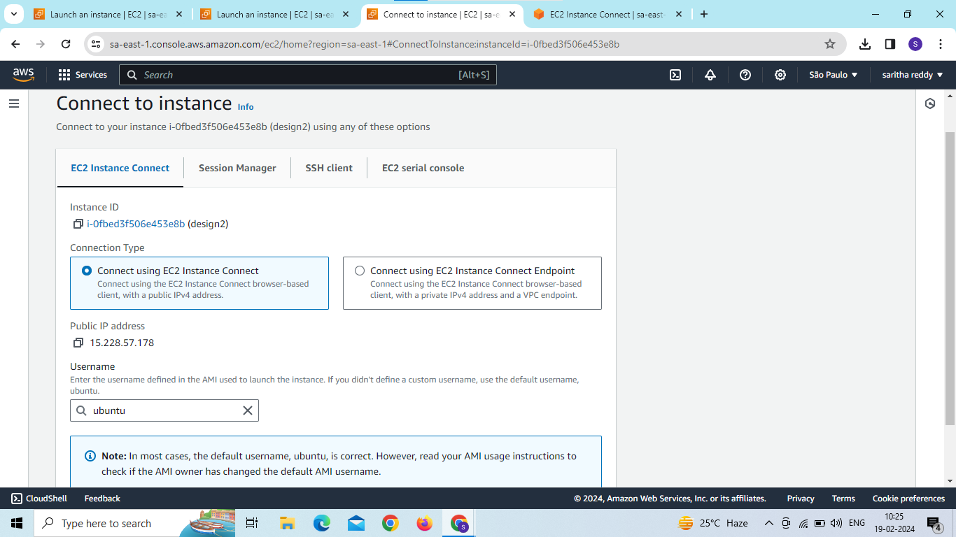
connect to instance

Slide 30
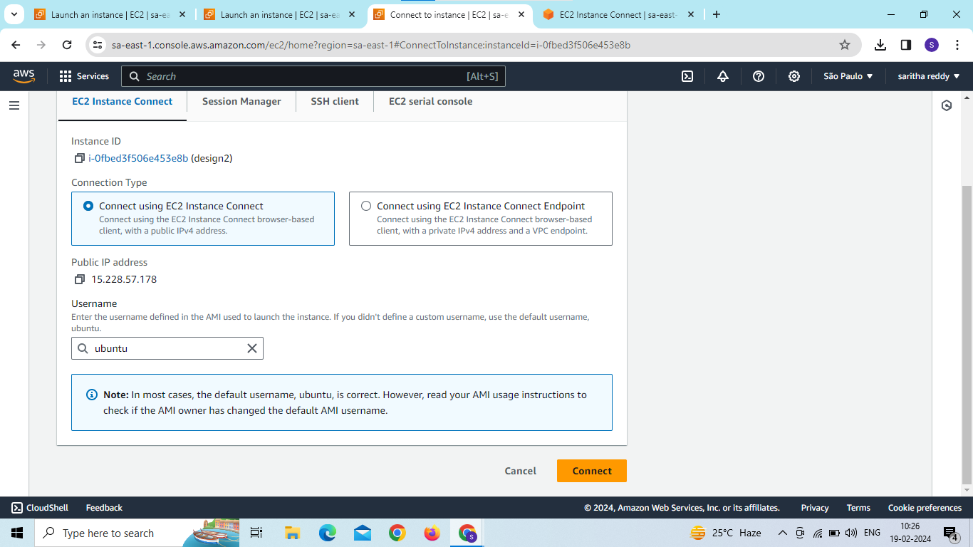

Slide 31
After attach volume to check file system is there or not then see the data in volume command is
file –s /dev/xvdf
Mkdir/data
Mount/dev/xvdf/data
Cd/data
ls

Slide 32
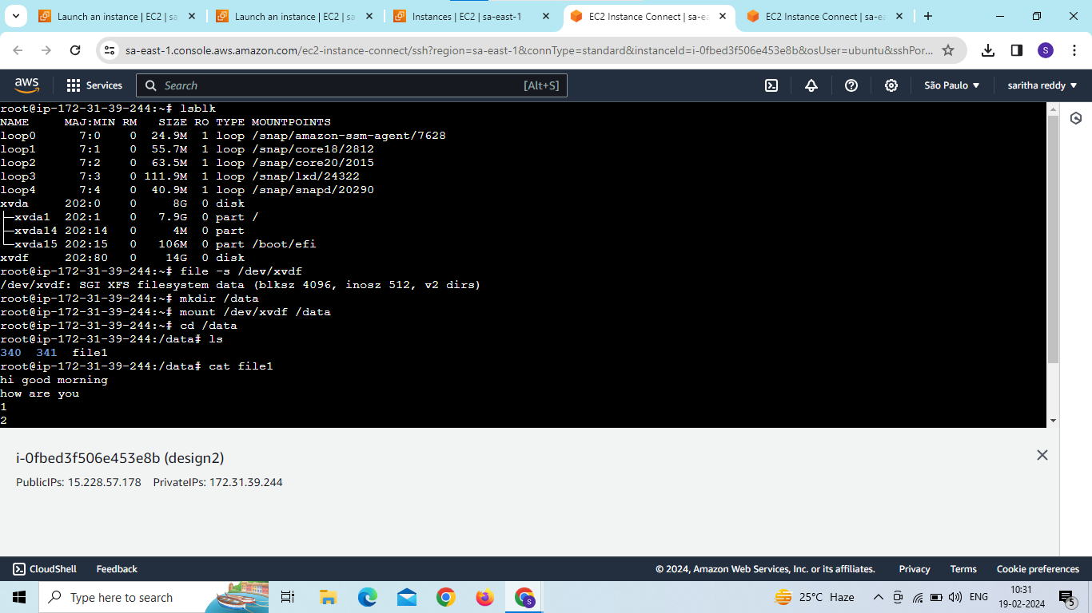
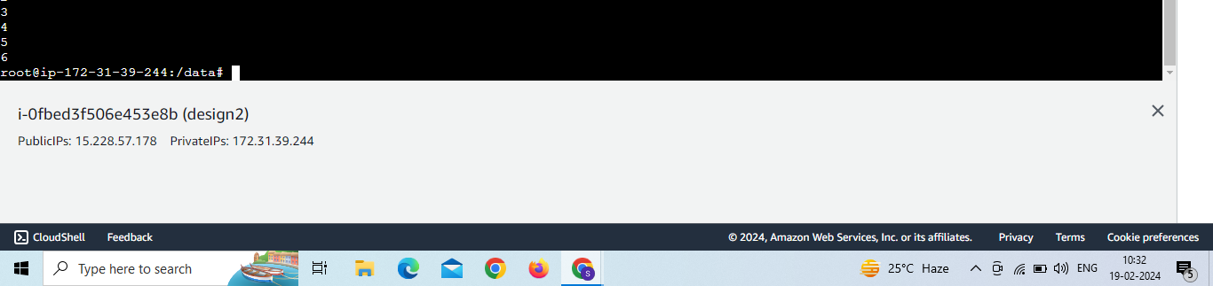

Slide 33
D.SARITHA dosalasaritha123@gmail.com Batch No:5pm-120 19-02-2024

Slide 34
Thank u

Slide 35
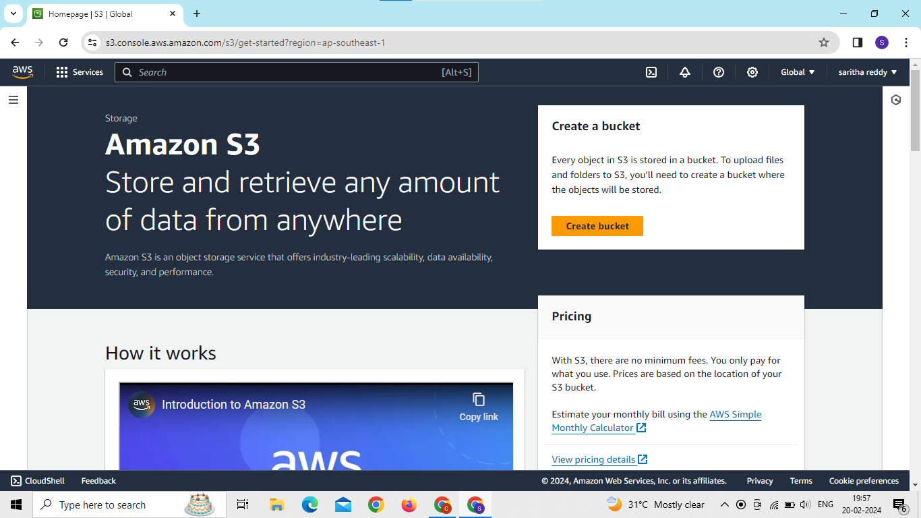
1.Create a s3 bucket and enable cross region replication for any two buckets in different regions?

Slide 36
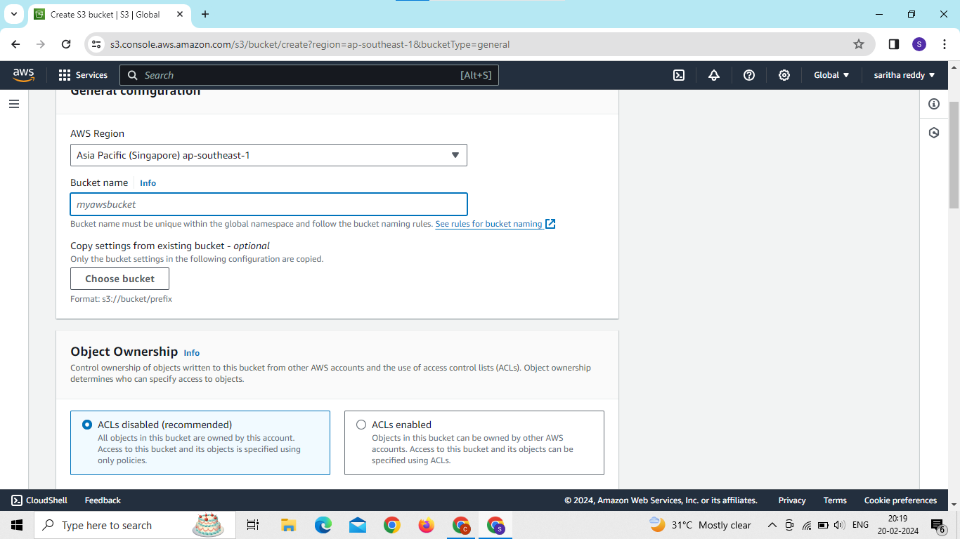
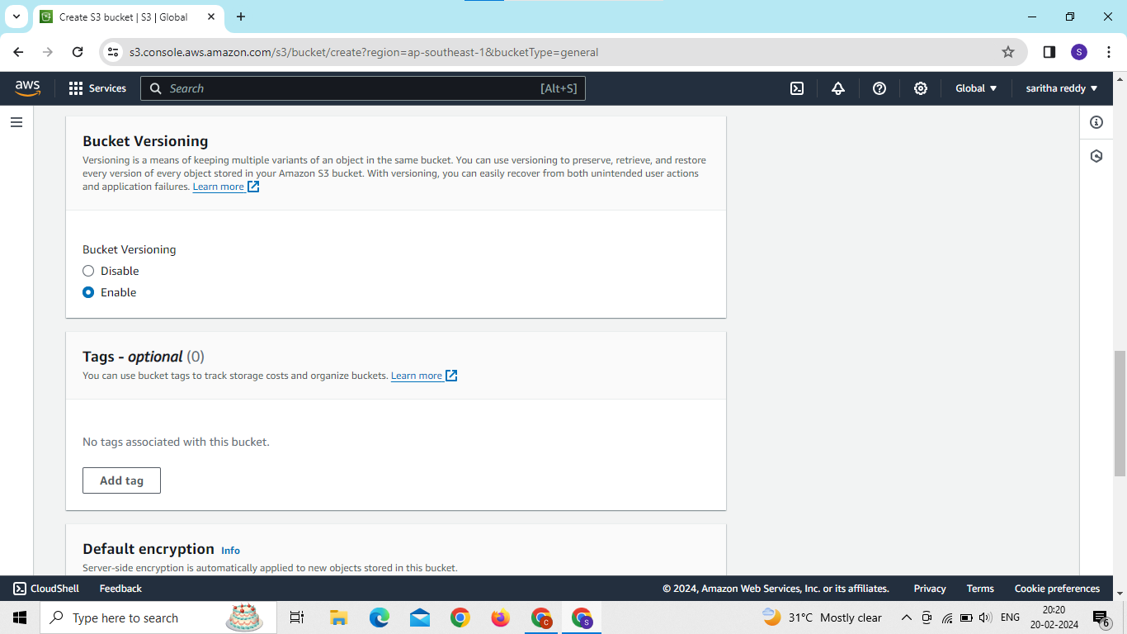
Create s3 bucket enable bucket versioning

Slide 37
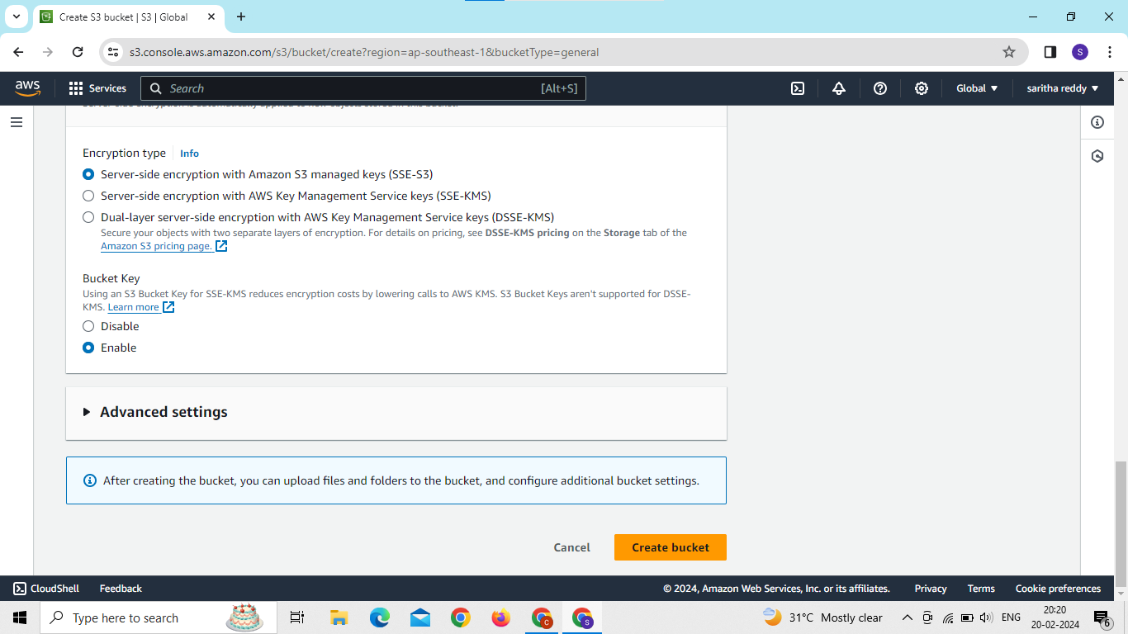
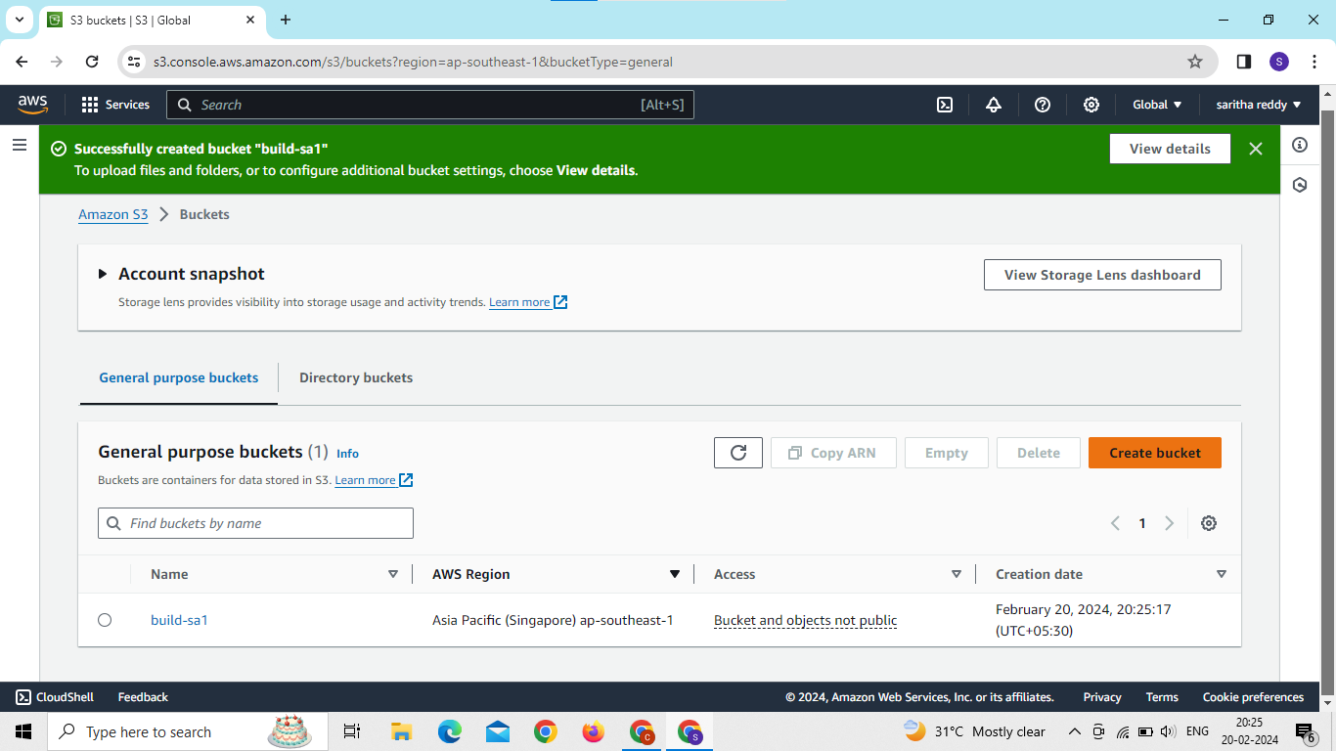

Slide 38
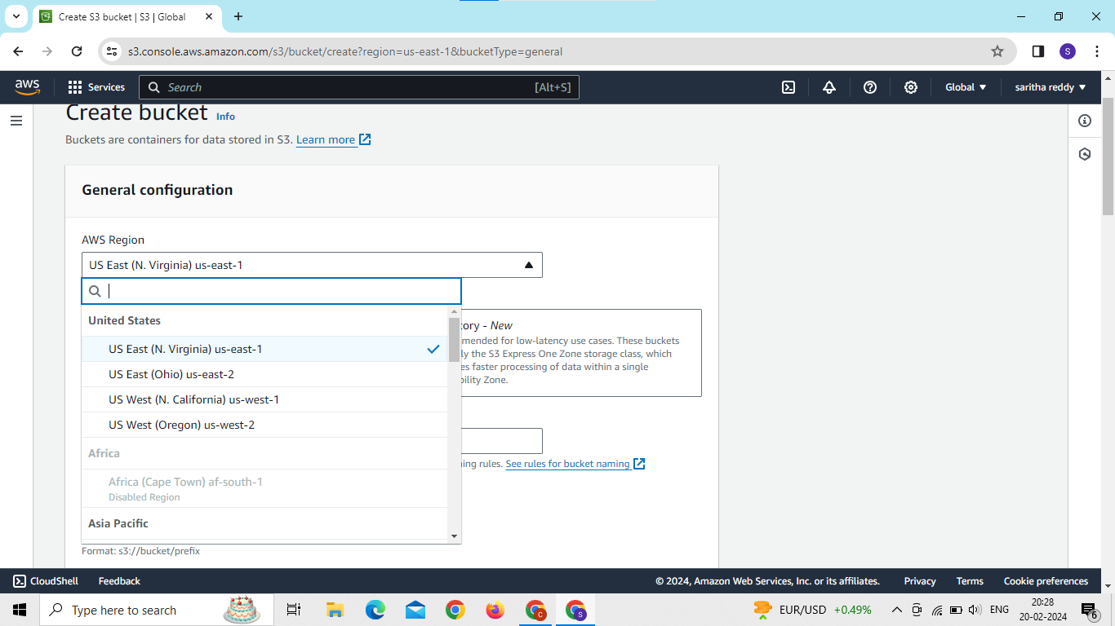
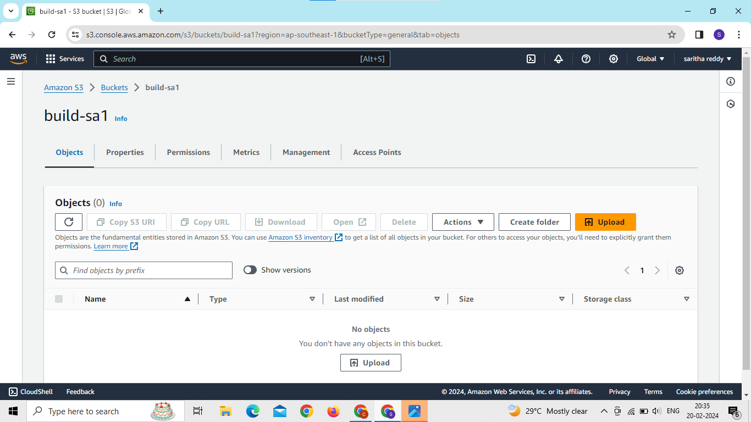
Create another bucket in another region

Slide 39
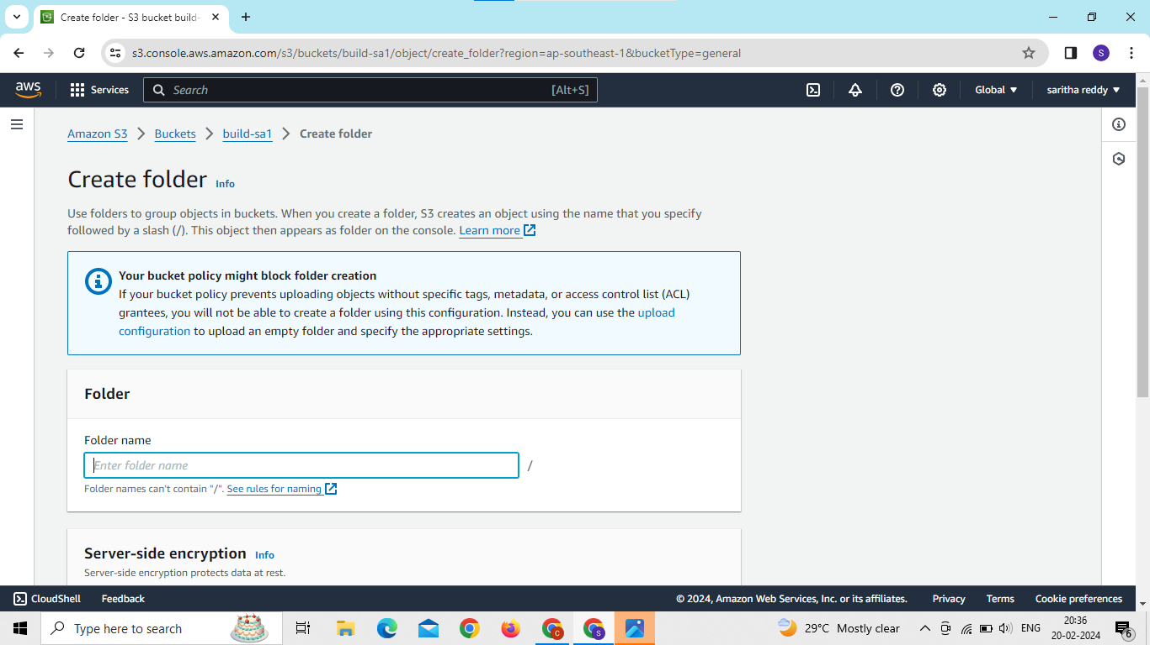
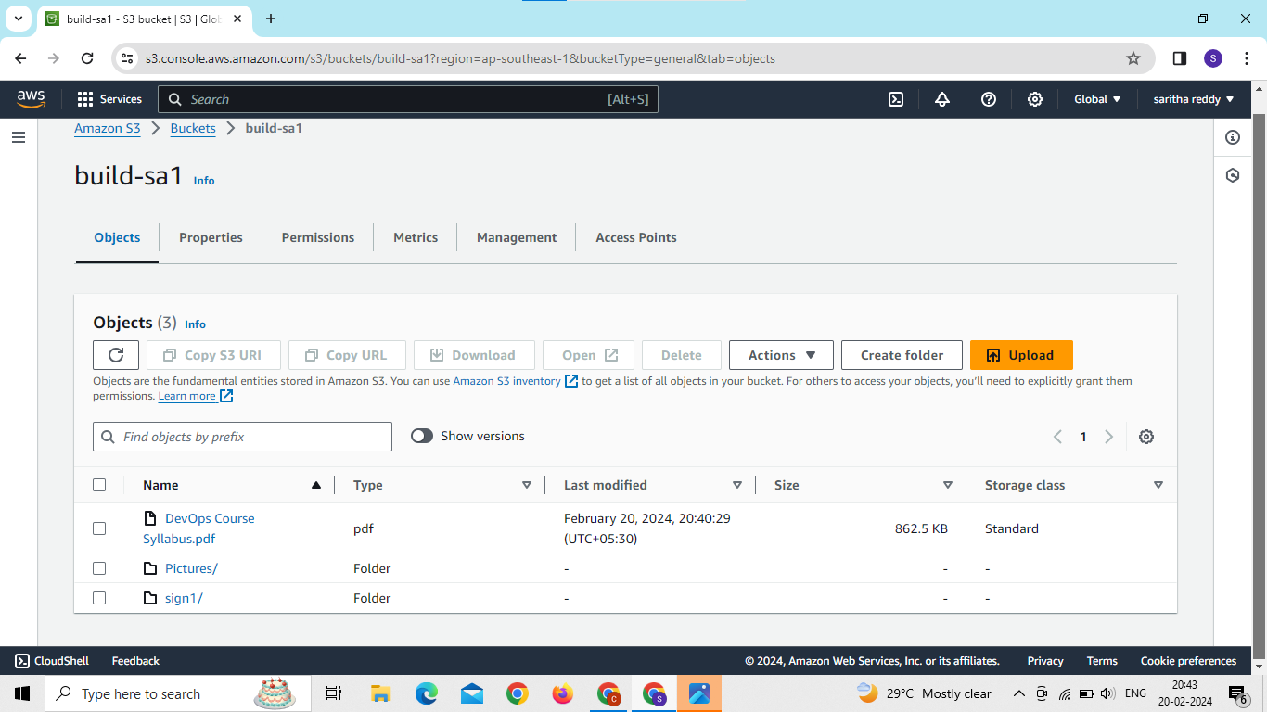
Now create folder and upload files on bucket 1

Slide 40
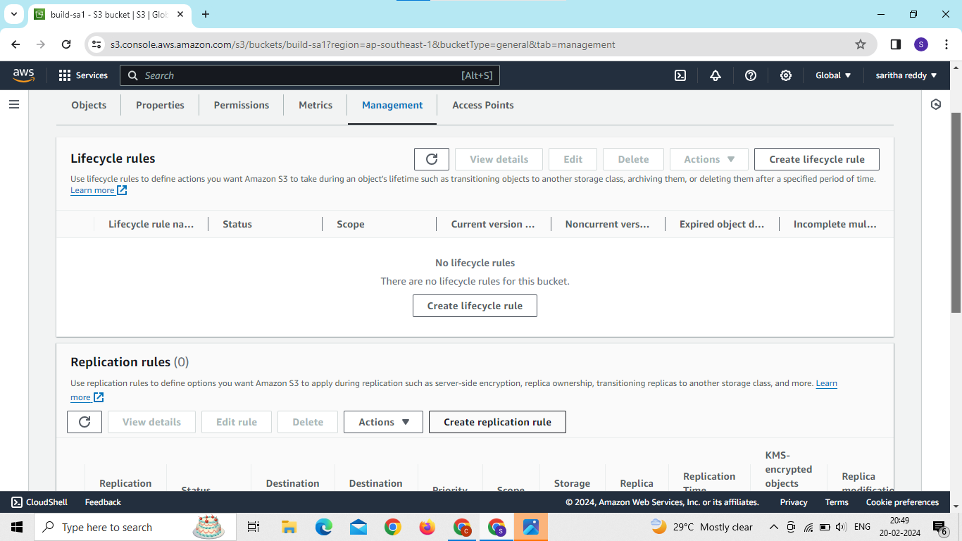
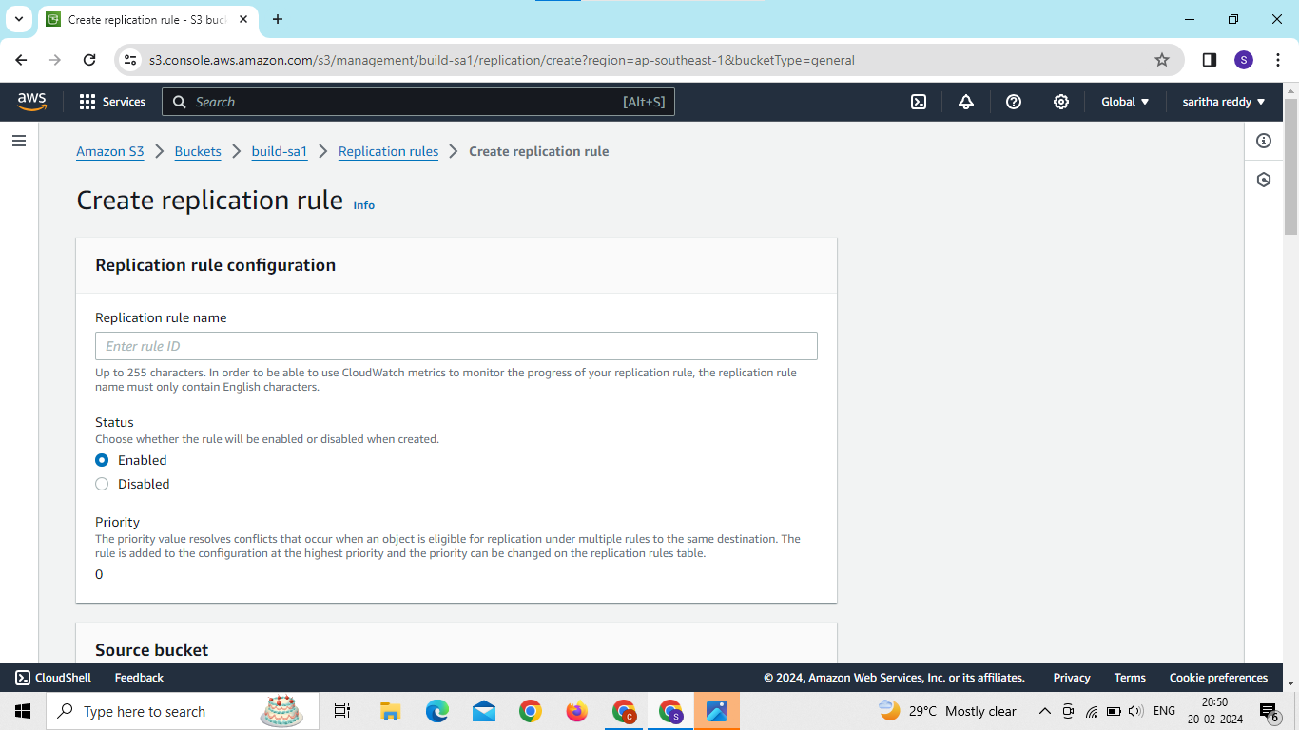
Now click on management and go to create replication

Slide 41
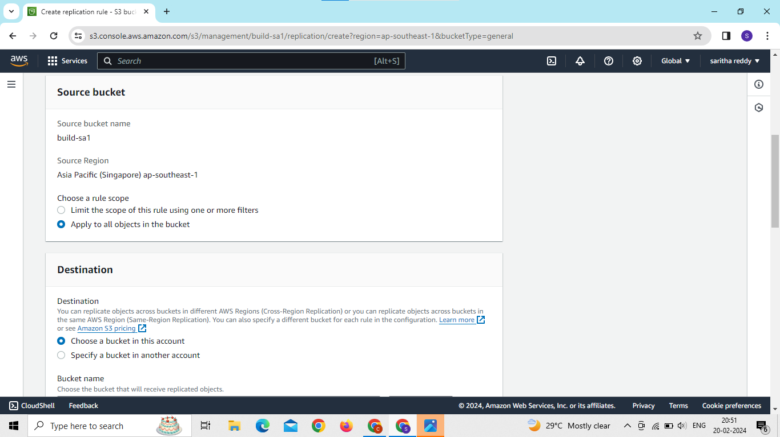
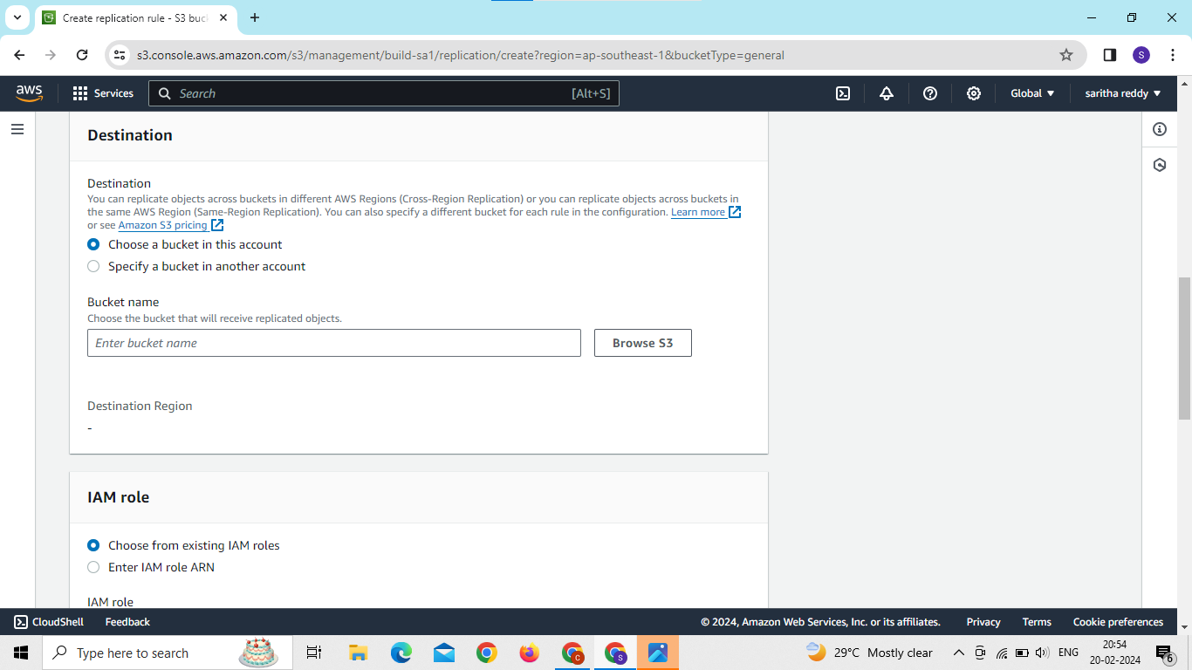

Slide 42
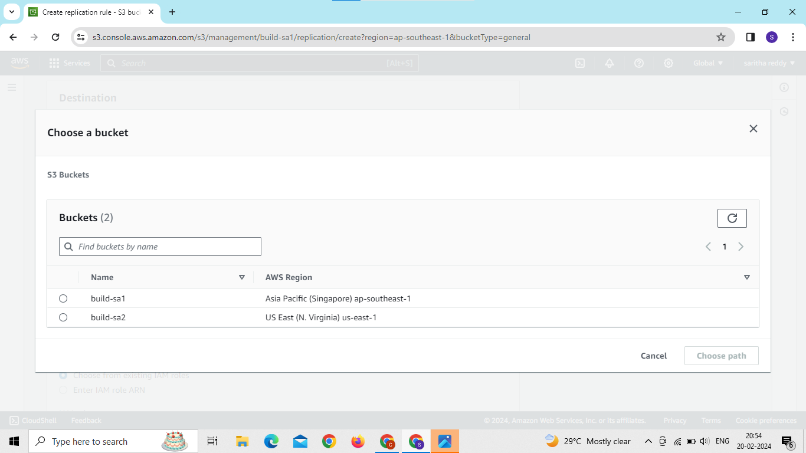
Now choose a destination bucket

Slide 43
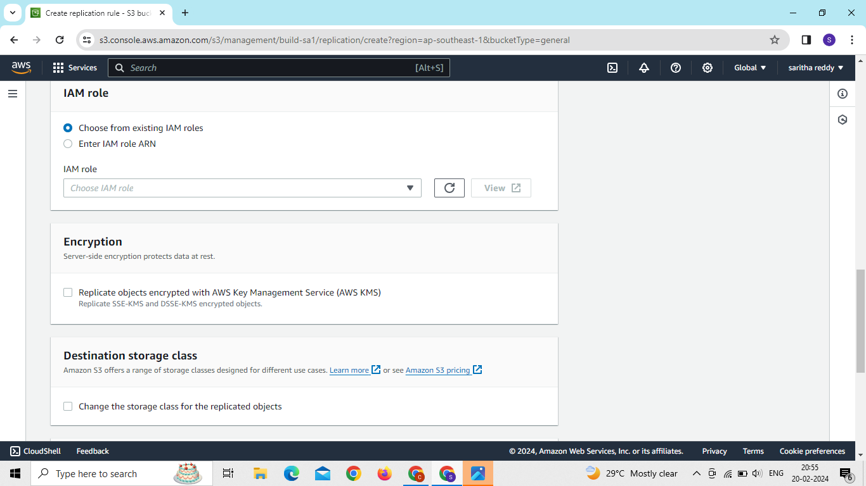
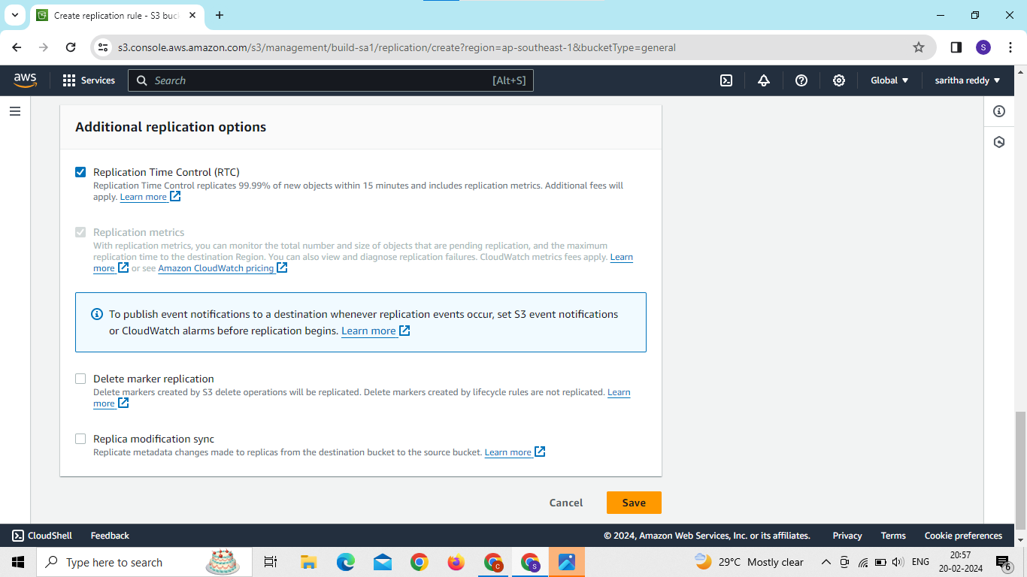

Slide 44
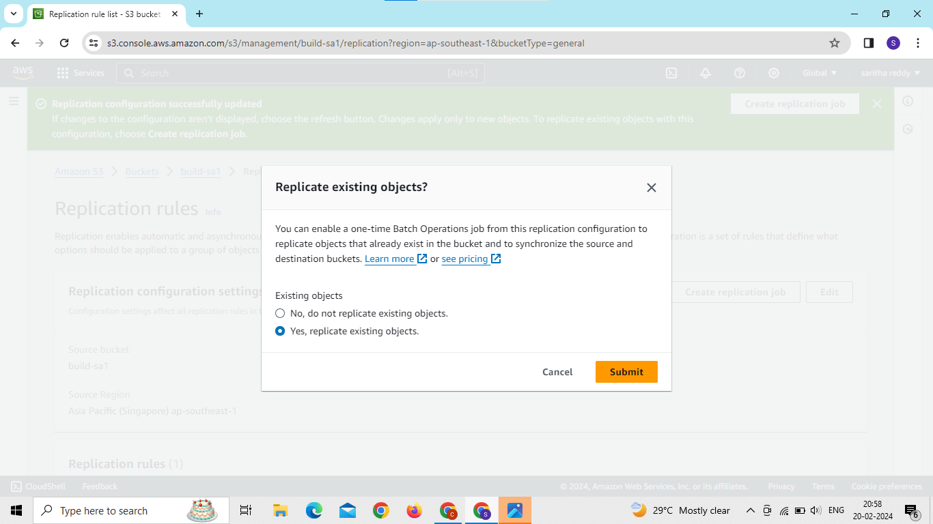
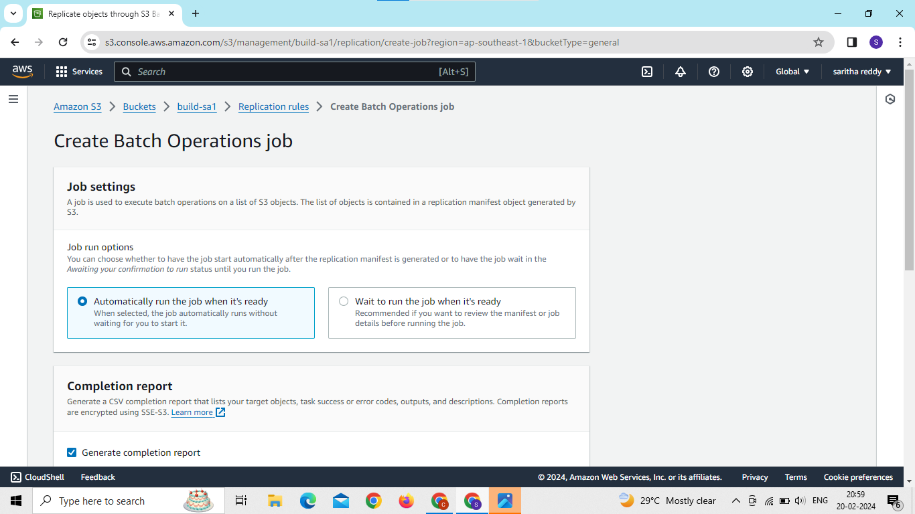

Slide 45
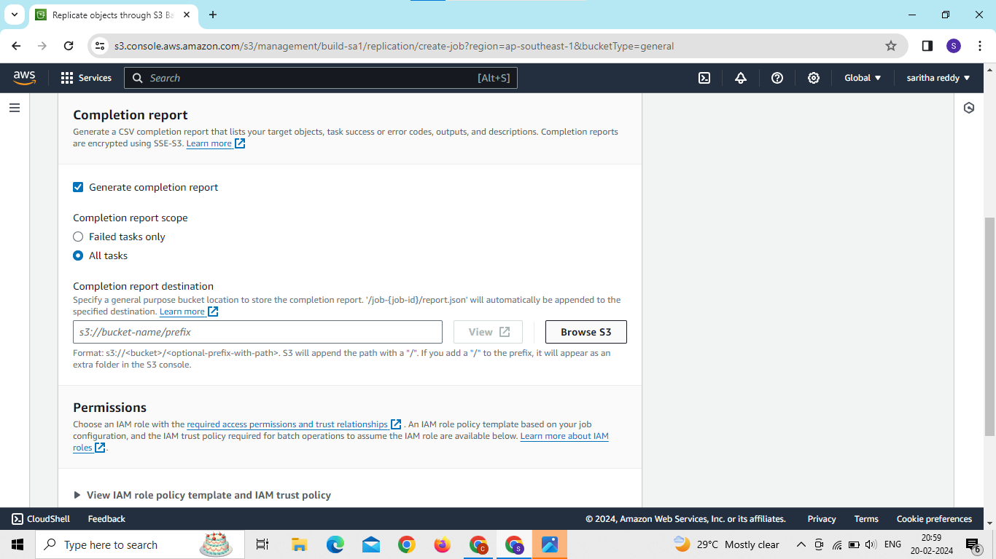
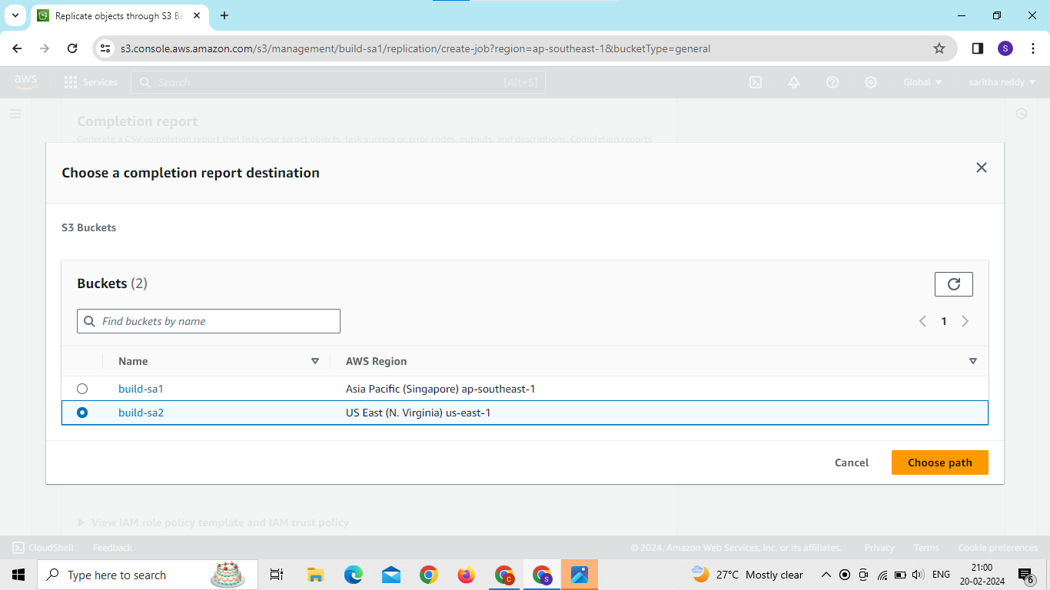

Slide 46
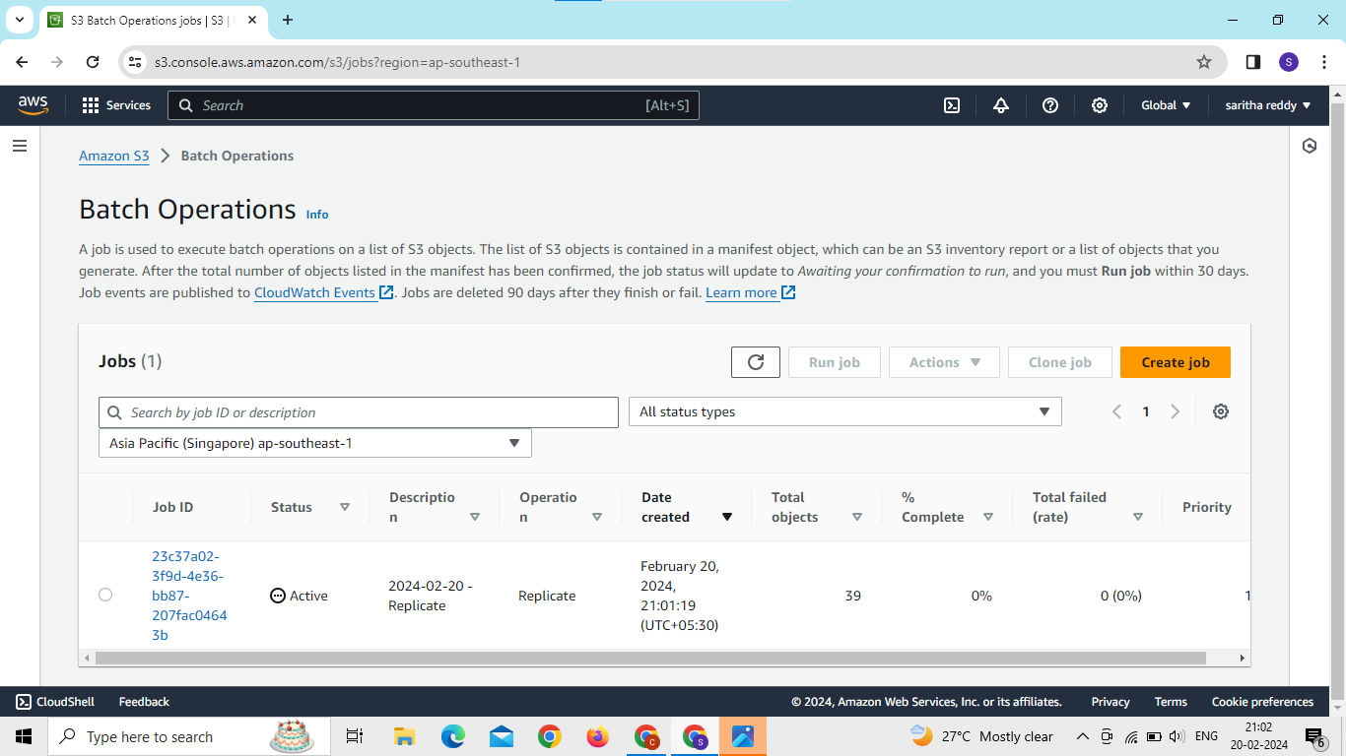
status is active files and folders in bucket 1 replicate to bucket 2

Slide 47

Now we can see the files in destination bucket

Slide 48
D.SARITHA dosalasaritha123@gmail.com Batch: 120-5pm
THANK YOU

